Slide 1
Oil production prediction
IHS data analyst interview
Yan Xu

Slide 2
Outline
Part 1 | Summarizing the result
Part 2 | Understanding data and changing data type
Part 3 | Processing missing data
Part 4 | Finding critical variables
Part 5 | Building training model
Part 6 | Improving prediction with Fixed effect model
Part 6 | Shortcomings and Future work

Slide 3
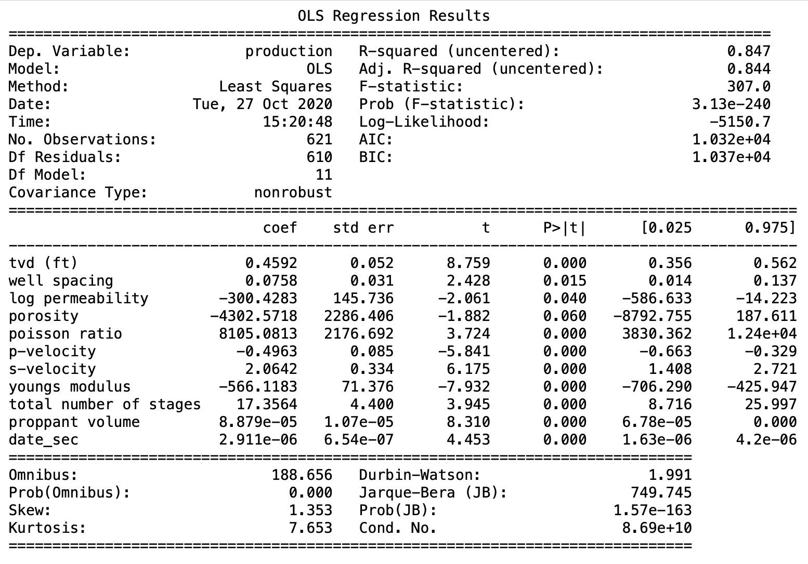
Part 1. Summarizing the result -- Using multi-linear regression model to predict oil production
Production
= 0.46*tvd(ft) + 0.08*well spacing – 300.43*log permeability – 4302.5718*porosity + 8105.08*poisson ratio -0.50*(p-velocity) + 2.06*(s-velocity)-566.12*youngs modulud + 17.36*total number of stages + 8.88*(e^(-5))*proppant volume + 2.91**(e^(-6))*date_sec - 0.05*operator
‘date_sec’ is the unix timestamp second
R-squared : 0.847
Adj. R-squared: 0.844

Slide 4
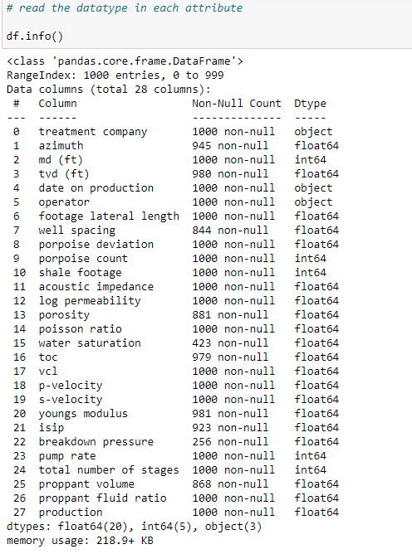
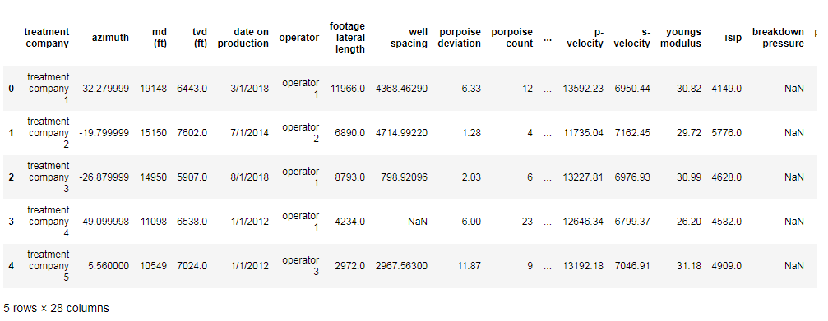
Part 2. Understanding data
For linear regression, all the variables should be int/float
‘treatment company’ and ‘operator’ are string
‘date on production’ is time
therefor, we need to covert the above three into int/float

Slide 5
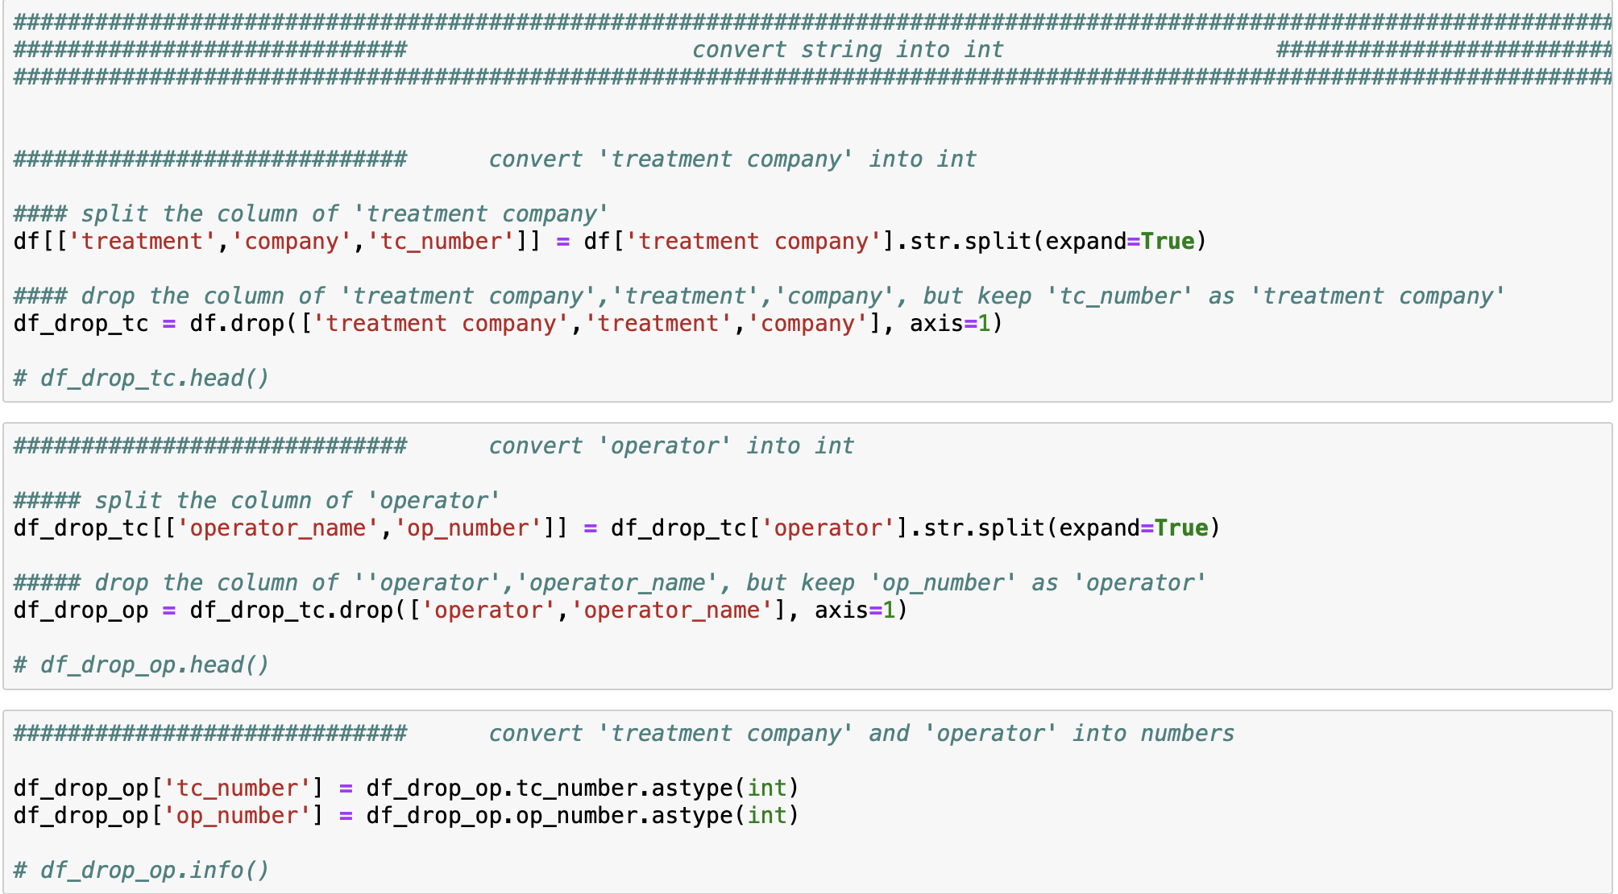
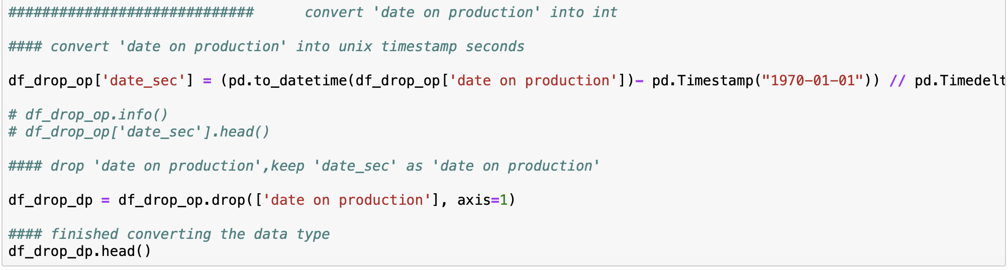
Part 2. changing data type
Converting ‘treatment company’ and ‘operator’ into int:
step 1: split the data into ‘name’ + ‘number’
step 2: convert the ‘number’ from string to ‘int’
step 3: drop the repeated ‘name’ (‘treatment’, ‘company’, ‘operator’)
one can also use dummy number to rename the two attributes
Converting ‘date on production’ into int:
step 1: converting date into the unix time stamp

Slide 6
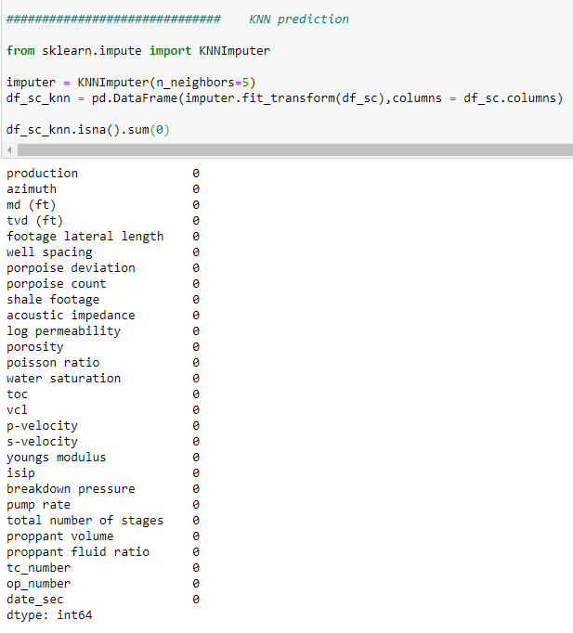
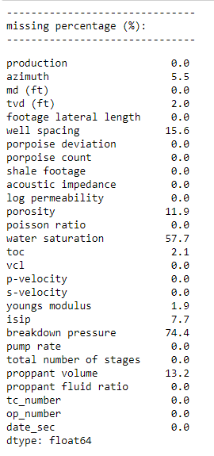
Part 3. Processing missing data
Using KNN model to prediction the missing data

Slide 7
Part 4. Finding critical variables
Critieria:
Using |P| value
according to reference, if |P value| < 0.05, the feature is significant
to be conservative, we choose |P value| < 0.2, and delete the value =>0.2
Using variance inflation factor (VIF)
Multicollinearity occurs when two or more predictors in the model are correlated
it provide redundant information about the response
Multicollinearity was measured by variance inflation factors (VIF) and tolerance
VIF >10 is not acceptable
Using correlation
the coefficient returns a value between -1 and 1
the value represents the limits of correlation from a full negative correlation to a full positive correlation
according to reference, |value| <0.1 means weak correlation
to be conservative, we choose |value| <0.01
Using Adj. R-squared
The selected variables should increase adj R2

Slide 8
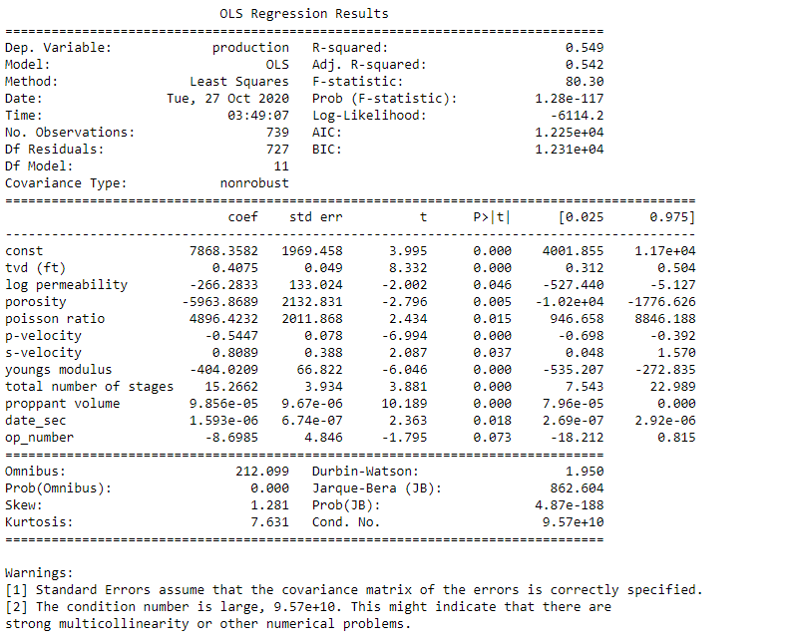
Part 4. Finding critical variables
After several test, the following variables are selected:
# 'tvd (ft)',
# 'well spacing',
# 'log permeability',
# 'porosity',
# 'poisson ratio',
# 'p-velocity',
# 's-velocity',
# 'youngs modulus',
# 'total number of stages',
# 'proppant volume',
# 'date_sec',
# 'op_number'

Slide 9
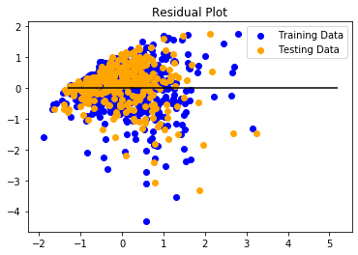
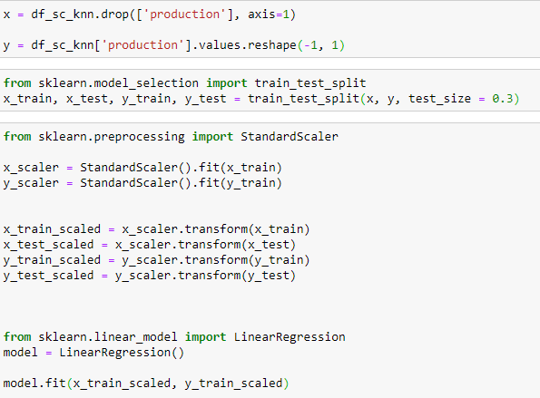
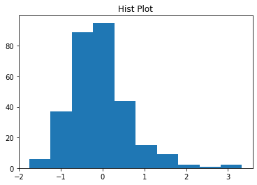
Part 5. Building training model
mean_squared_error: 0.5
Mean_absolute_error:0.5
R²: 0.54

Slide 10
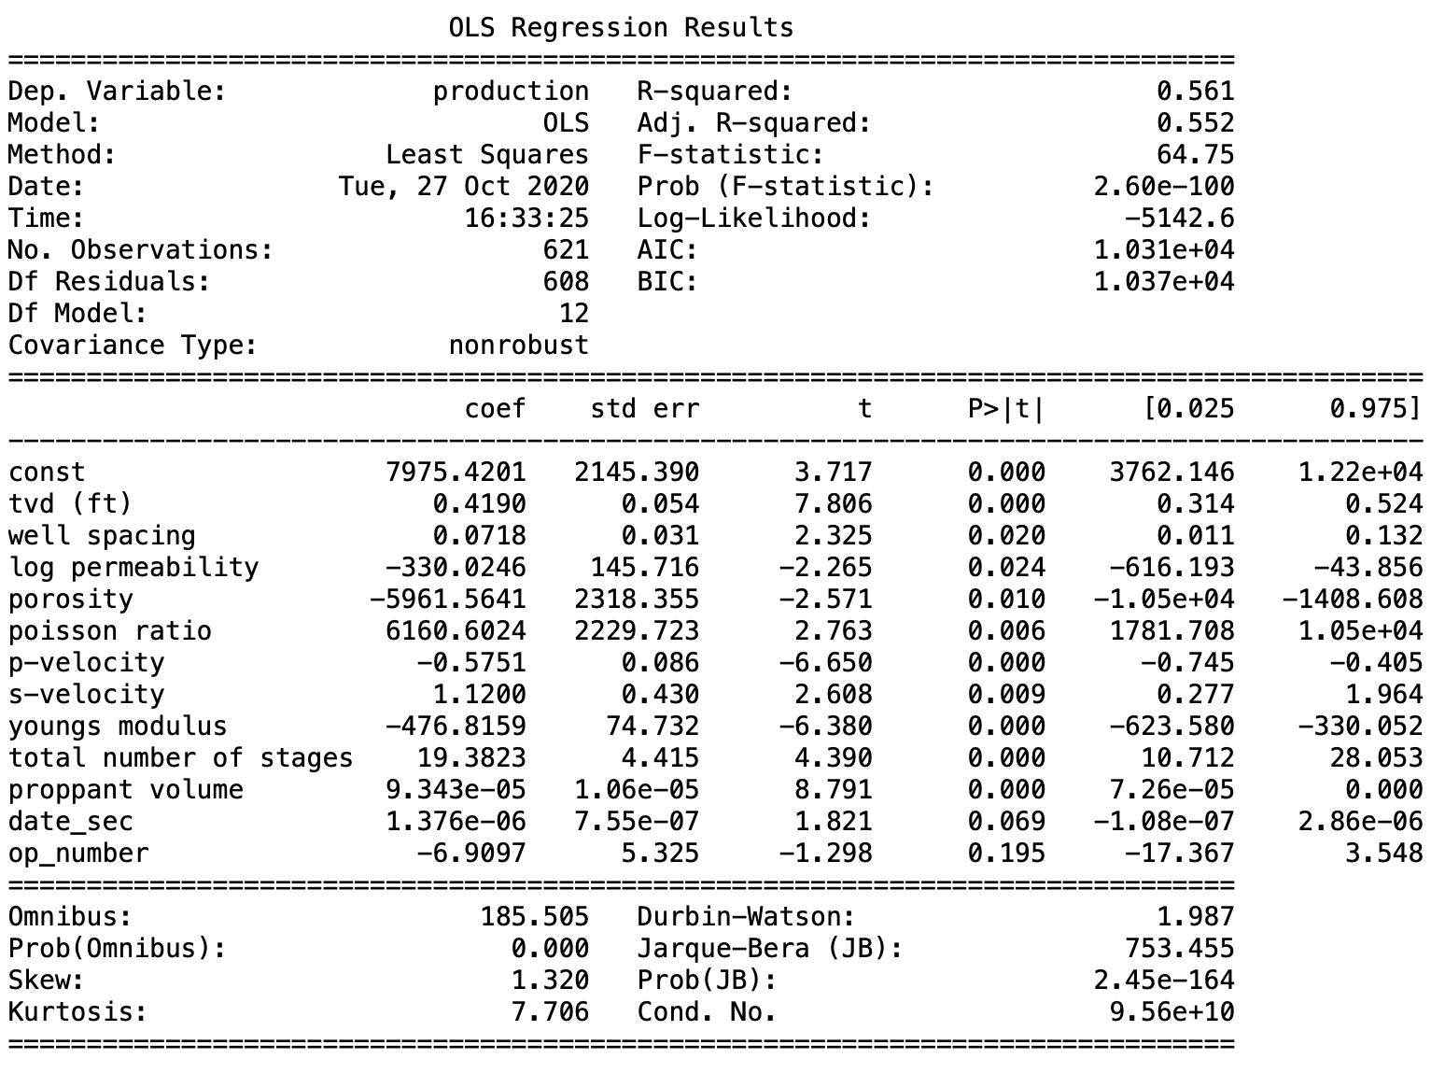
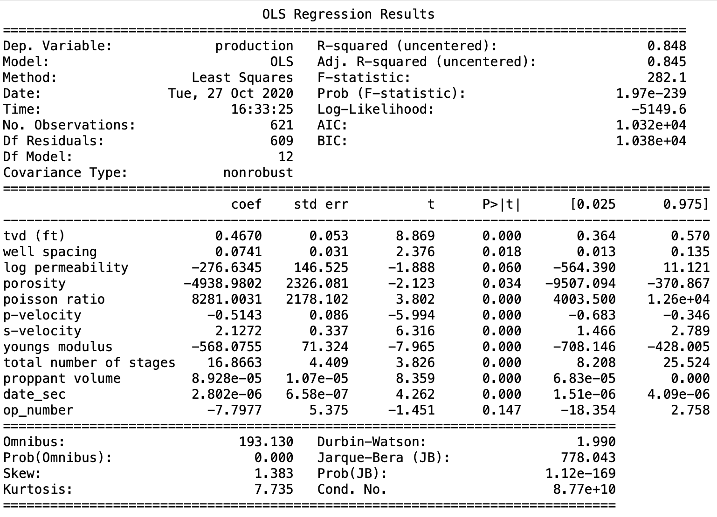
Part 6. Improving prediction with Fixed effect model
Prediction without Fixed effect
Prediction with Fixed effect
‘op_number’ is ‘operator’

Slide 11
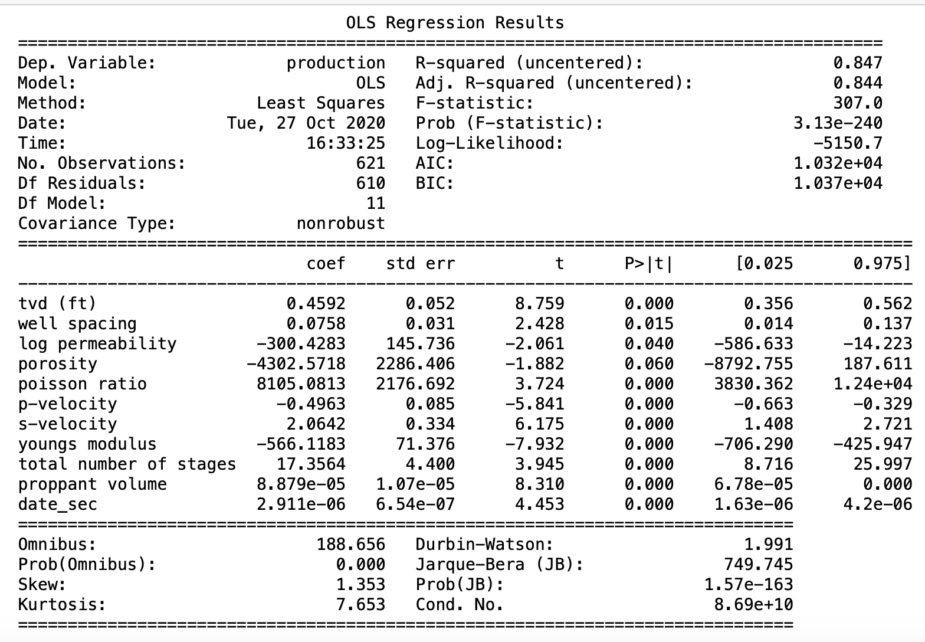
Part 6. Improving prediction with Fixed effect model
Prediction with Fixed effect & delete ‘operator’
‘operator’ has |p|>0.1
Prediction with Fixed effect
‘op_number’ is ‘operator’

Slide 12
Part 7. Shortcomings and Future work
If time allowed, I can to the following:
Explain each variables
Learn more from the related publications to justify the selected variables
Explain why the variable matters
Improve R^2
Using deep learning model to improve the fitting

